Slide 1
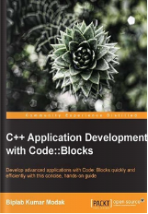


C++ Application Development with Code::Blocks
001
001 Opening and Introduction
GitHub: https://github.com/yasenstar/learn_cpp/tree/main/cpp_blocks

Slide 2
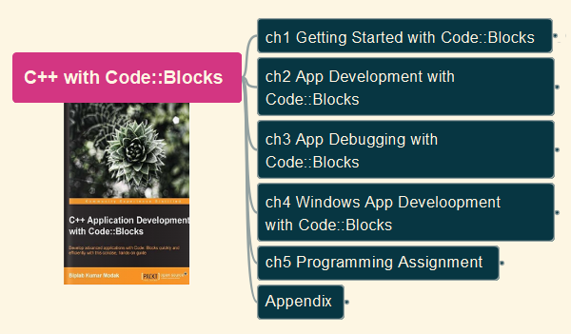
Contents
Learn C++ Programming from Scratch
Familiar and Use Code::Blocks as Tool
Examine the Book in Year 2024 Context
Gain Experience for Further C++ Learning
Learning by Practicing and Keeping Fun!
Thanks for Author: Biplab Kumar Modak

Slide 3
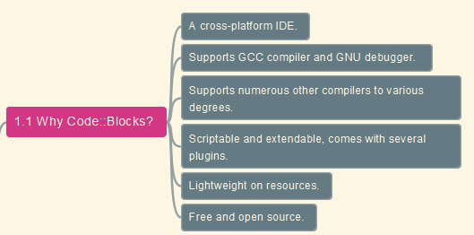
Why Code::Blocks?

Slide 4
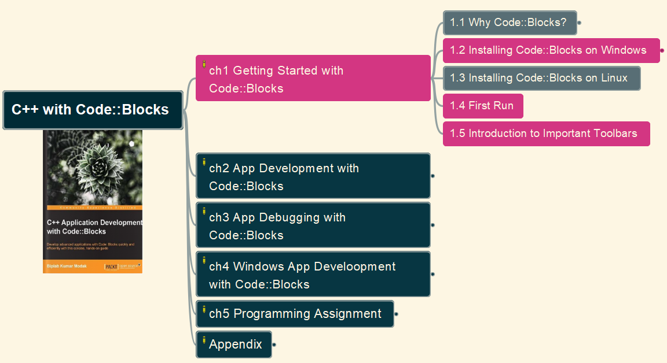
Install Code::Blocks on Windows
002
GitHub: https://github.com/yasenstar/learn_cpp/tree/main/cpp_blocks

Slide 5
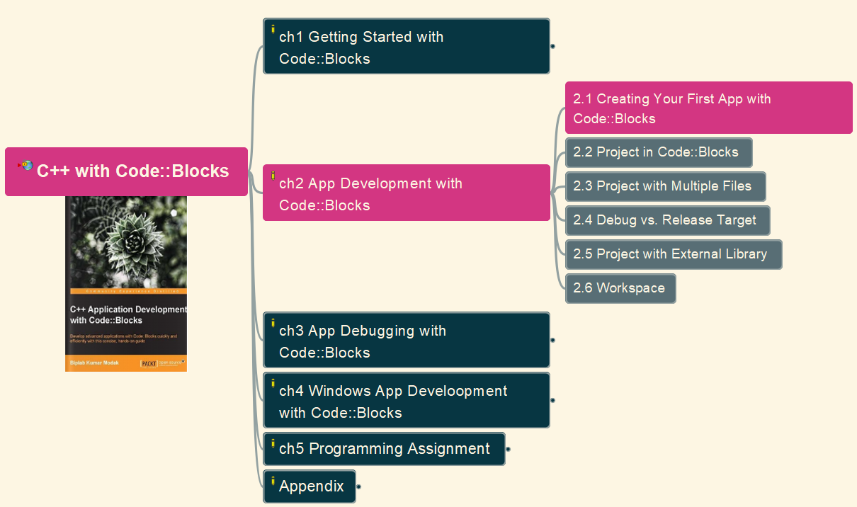
Create First App with Code::Blocks
003
GitHub: https://github.com/yasenstar/learn_cpp/tree/main/cpp_blocks

Slide 6
2.2 Project in Code::Blocks
004
GitHub: https://github.com/yasenstar/learn_cpp/tree/main/cpp_blocks

